Slide 1
Docker
A DevOps love story ☺
Abdulrahman Azab
25, May

Slide 2
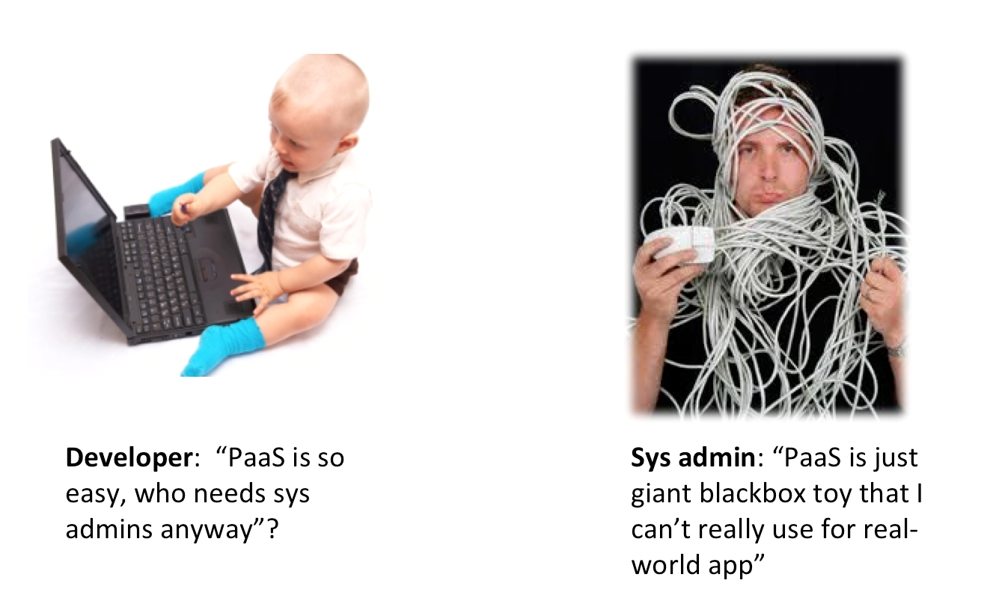
DevOps

Slide 3
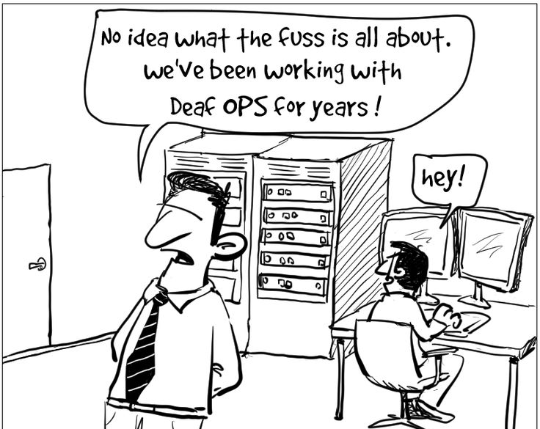
DevOps

Slide 4
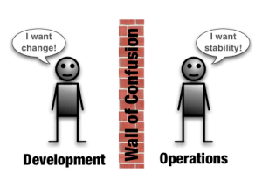
DevOps

Slide 5



Slide 6
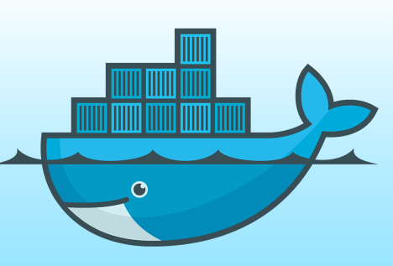
Docker
Docker is an open-source project that automates
the deployment of applications inside software
containers, by providing an additional layer of
abstraction and automation of operating system–
level virtualization on Linux.
[www.docker.com]

Slide 7
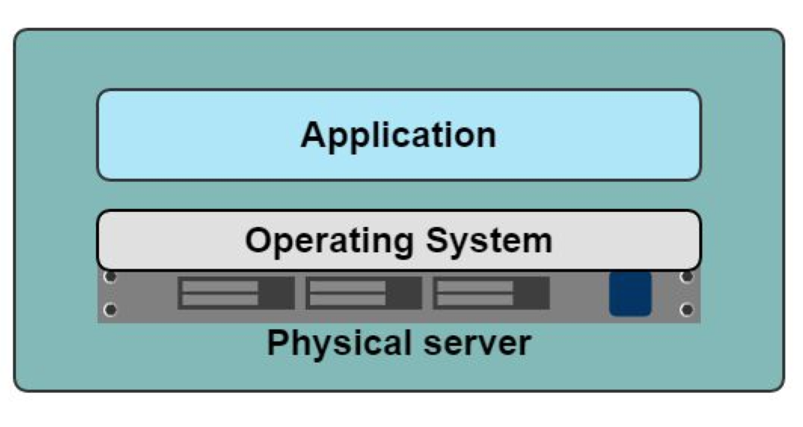
Application-Server
Slow deployment
Huge cost
Wasted resources
Difficult to Scale
Difficult to Migrate

Slide 8
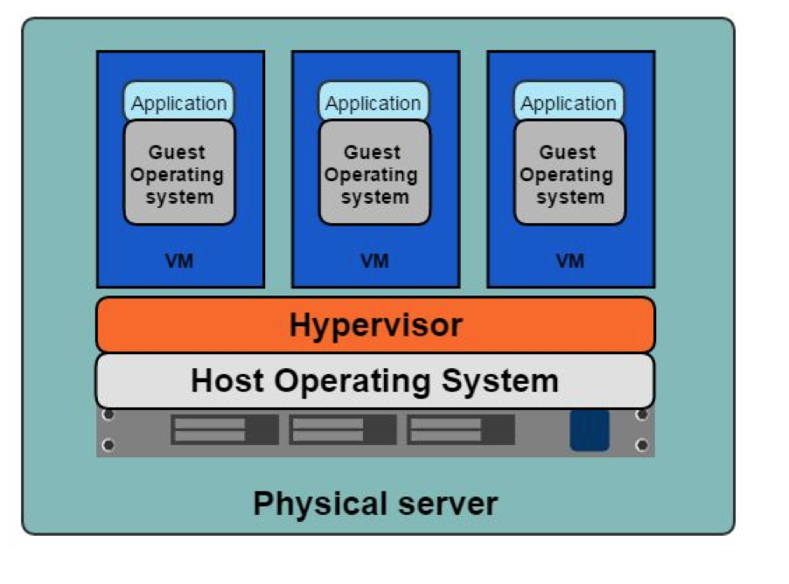
VMs
Benefits
Better resource pooling
Easier to scale
VM’s on the cloud.
Limitations
Dedicated resources for each VM (more VM = more resources).
Guest VM = Wasted resources.

Slide 9
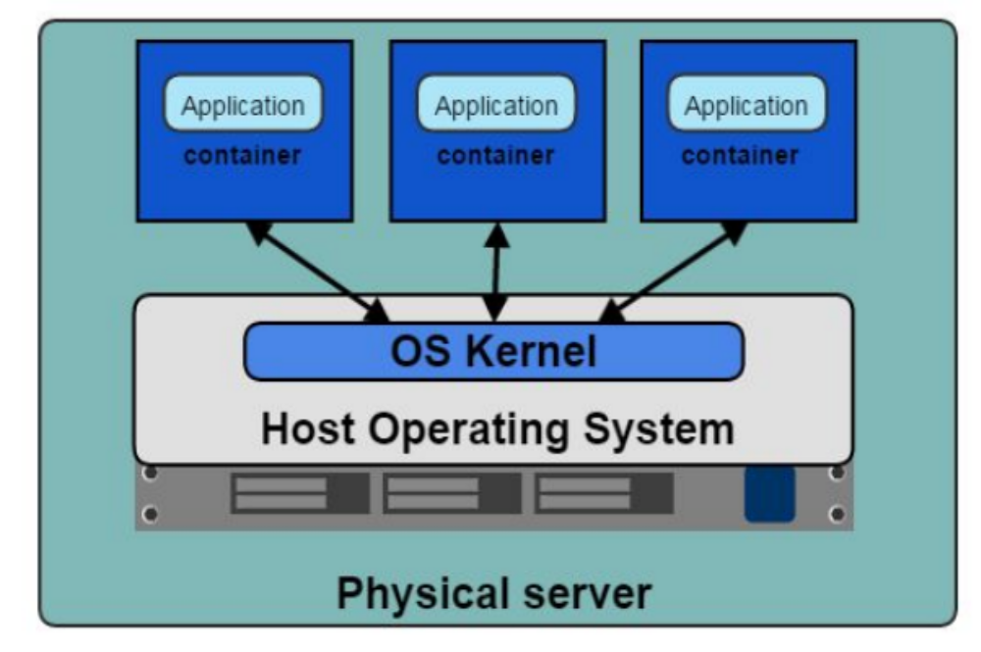
Containers

Slide 10
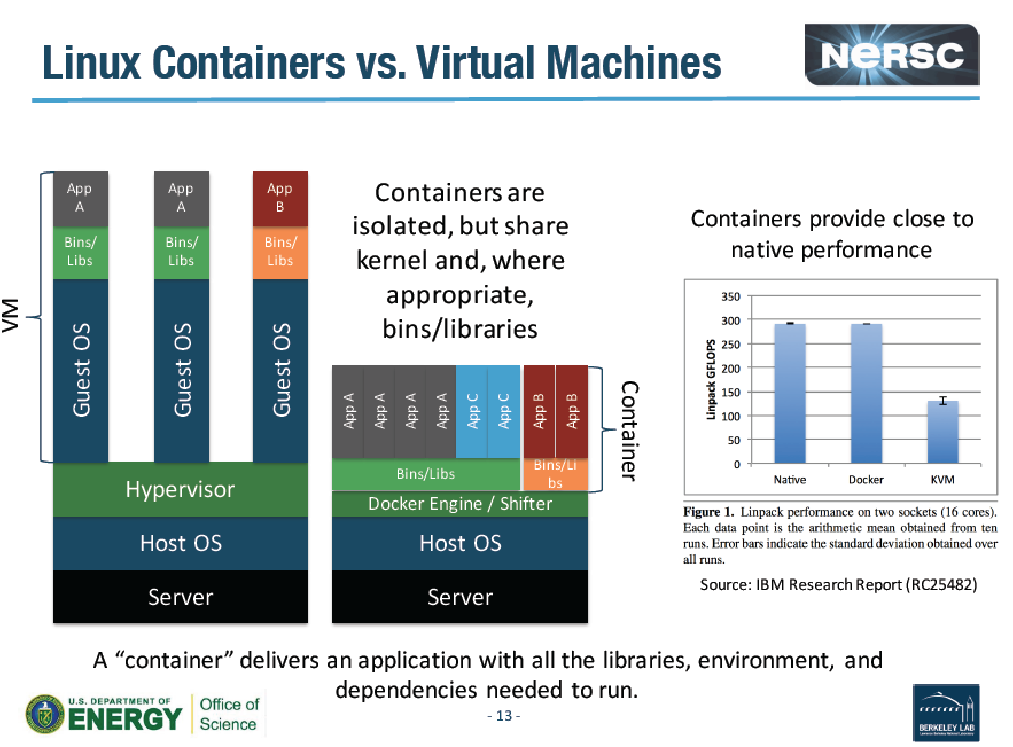
Docker
Notes:
LINPACK is a software library for performing numericallinear algebra on digital computers. It was written in Fortran. and was intended for use on supercomputers in the 1970s and early 1980s.

Slide 11
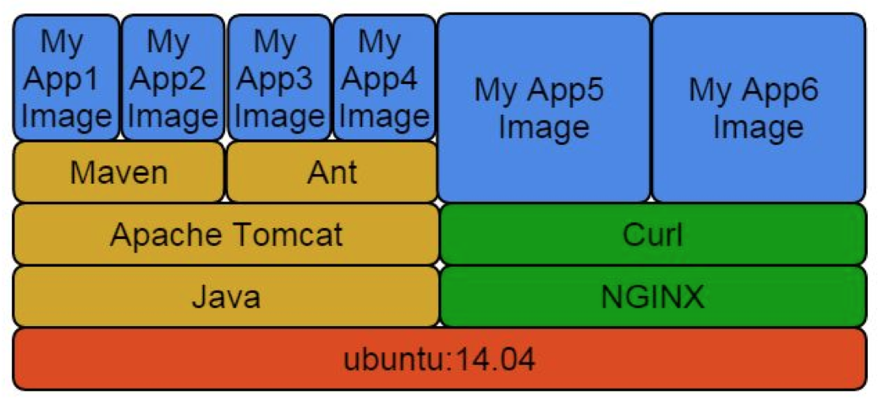
Docker Layers

Slide 12
Images and Layers
ubuntu : 200 Mb
ubuntu + R : 250 Mb
ubuntu + matlab : 250 Mb
All three: 300 Mb

Slide 13
Containers
Containers vs VMs
Containers are more lightweight.
No need for a guest OS.
Less resources.
Greater portability
Faster

Slide 14
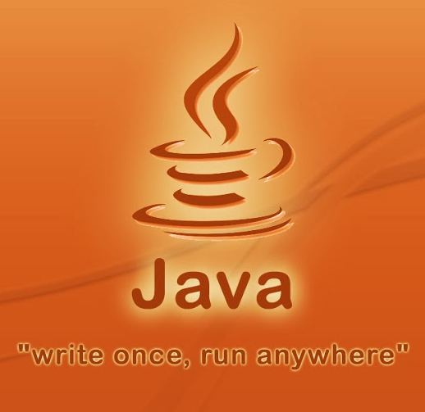
In short:
Build once run anywhere

Slide 15
Ready for fun?..
Access your VM

Slide 16


192.168.1.33
86.50.170.193
192.168.1.58-77
[your-username@your-machine]$ ssh -i docker-tutorial.pem cloud-user@86.50.170.193
[cloud-user@docker-tutorial-1-11 ~]$ ssh -i docker-tutorial.pem cloud-user@192.168.1.58

Slide 17
Let’s get our hands
dirty ☺
Google “docker install”

Slide 18
goto Docker tutorial…

Slide 19
…return

Slide 20
Building a Docker Image
Interactive building
Building from a Docker File
Base Image (Disk)
Base Image (Disk)
Run
Load
Run the
Installation
procedure
Container (Memory)
Dockerfile
Installation
script
Commit
Build
New Image (Disk)
New Image (Disk)

Slide 21
Interactive building Example: curl & vim
$ docker run -t -i ubuntu:14.04
root@2a896c8cdd83:/# apt-get update-y
root@2a896c8cdd83:/# apt-get install -y curl
root@2a896c8cdd83:/# apt-get install -y vim
root@2a896c8cdd83:/# exit
$ docker commit 2a896c8cdd83 youruser/curlvim:1.0
$ docker run youruser/test:1.0 curl --version
curl 7.35.0 (x86_64-pc-linux-gnu) libcurl/7.35.0 OpenSSL/1.0.1f zlib/1.2.8 libidn/1.28 librtmp/2.3
Protocols: dict file ftp ftps gopher http https imap imaps ……..
$ docker login
$ docker push youruser/curlvim:1.0
Hands-on

Slide 22
Interactive building Example: Bowtie2
$ docker run -t -i ubuntu:14.04
root@2a896c8cdd83:/# apt-get update -qq --fix-missing
root@2a896c8cdd83:/# apt-get install -qq -y wget unzip
root@2a896c8cdd83:/# wget -q -O bowtie2.zip http://sourceforge.net/projects/bowtie-bio/files/bowtie2/2.2.4/bowtie2-2.2.4-linux-x86_64.zip/download
root@2a896c8cdd83:/# unzip bowtie2.zip -d /opt/
root@2a896c8cdd83:/# ln -s /opt/bowtie2-2.2.4/bowtie2 /usr/bin/bowtie2
root@2a896c8cdd83:/# rm bowtie2.zip
root@2a896c8cdd83:/# exit
$ docker commit 2a896c8cdd83 youruser/bowtie2
$ docker run youruser/bowtie2 bowtie2 --version
/bowtie2/bowtie2-align version 2.1.0
64-bit
Built on do-dmxp-mac.win.ad.jhu.edu
Tue Feb 26 13:34:02 EST 2013
……..
Hands-on
$ docker login
$ docker push youruser/bowtie2

Slide 23
Building a Docker Image from a Dockerfile
<source-directory>
Dockerfile
files
.dockerignore
$docker build -t <image-name> <source-directory>

Slide 24
Dockerfile Example: curl & vim
FROM ubuntu:14.04
MAINTAINER your name <your email>
RUN apt-get update -y
RUN apt-get install curl -y
RUN apt-get install vim -y

Slide 25
Dockerfile Example: curl & vim
FROM ubuntu:14.04
MAINTAINER your name <your email>
RUN apt-get update -y
RUN apt-get install curl -y && apt-get install vim -y

Slide 26
Dockerfile Example: Bowtie2
FROM ubuntu:14.04
RUN apt-get update -qq --fix-missing; \
apt-get install -qq -y wget unzip;
RUN wget -q -O bowtie2.zip http://sourceforge.net/projects/bowtie-bio/files/bowtie2/2.2.4/bowtie2-2.2.4-linux-x86_64.zip/download; \
unzip bowtie2.zip -d /opt/; \
ln -s /opt/bowtie2-2.2.4/ /opt/bowtie2; \
rm bowtie2.zip
ENV PATH $PATH:/opt/bowtie2

Slide 27
Inspect containers
$ docker ps # shows running containers.
$ docker inspect # info on a container (incl. IP address).
$ docker logs # gets logs from container.
$ docker events # gets events from container.
$ docker port # shows public facing port of container.
$ docker top # shows running processes in container.
$ docker diff # shows changed files in container's FS.
$ docker stats # shows metrics, memory, cpu, filsystem
http://www.jayway.com/2015/03/21/a-not-very-short-introduction-to-docker/

Slide 28
Containers
# Run a container interactively
$ docker run -it --rm ubuntu
# Run a container in the background
$ docker run -d hadoop
# Publish container port 80 on a random port on the Host
$ docker run -p 80 nginx
# Publish container port 80 on port 8080 on the Host
$ docker run -p 8080:80 nginx
http://www.jayway.com/2015/03/21/a-not-very-short-introduction-to-docker/
Notes:
--interactive (-i) – send stdin to the process.
-tty (-t) – tell the process that a terminal is present. This affects how the process outputs data and how it treats signals such as (Ctrl-C).
--rm – remove the container on exit.
ubuntu – use the ubuntu:latest image.
--detached (-d) – Run in detached mode, you can attach again with docker attach

Slide 29
Containers
# Publish container port 80 on port 8080 on the localhost interface on the Host
$ docker run -p 127.0.0.1:8080:80 nginx
# Publish all EXPOSEd ports from the container on random ports on the Host
$ docker run -P nginx
http://www.jayway.com/2015/03/21/a-not-very-short-introduction-to-docker/
Notes:
--interactive (-i) – send stdin to the process.
-tty (-t) – tell the process that a terminal is present. This affects how the process outputs data and how it treats signals such as (Ctrl-C).
--rm – remove the container on exit.
ubuntu – use the ubuntu:latest image.
--detached (-d) – Run in detached mode, you can attach again with docker attach

Slide 30
Containers
# Limit the amount of memory
$ docker run -m 256m yourapp
# Limit the number of shares of the CPU this process uses (out of 1024)
$ docker run --cpu-shares 512 mypp
# Change the user for the process to www instead of root (good for security)
$ docker run -u=www nginx
http://www.jayway.com/2015/03/21/a-not-very-short-introduction-to-docker/
Notes:
--interactive (-i) – send stdin to the process.
-tty (-t) – tell the process that a terminal is present. This affects how the process outputs data and how it treats signals such as (Ctrl-C).
--rm – remove the container on exit.
ubuntu – use the ubuntu:latest image.
--detached (-d) – Run in detached mode, you can attach again with docker attach

Slide 31
Volumes
# Start a new nginx container with /var/log as a volume (created)
$ docker run -v /var/log nginx
# Start a new nginx container with /var/log as a volume mapped to /tmp on Host
$ docker run -v /tmp:/var/log nginx
# Start a db container
$ docker run -v /var/lib/postgresql/data --name mydb postgres
# Start a backup container with the volumes taken from the mydb container
$ docker run --volumes-from mydb backup
http://www.jayway.com/2015/03/21/a-not-very-short-introduction-to-docker/
Notes:
--interactive (-i) – send stdin to the process.
-tty (-t) – tell the process that a terminal is present. This affects how the process outputs data and how it treats signals such as (Ctrl-C).
--rm – remove the container on exit.
ubuntu – use the ubuntu:latest image.
--detached (-d) – Run in detached mode, you can attach again with docker attach

Slide 32
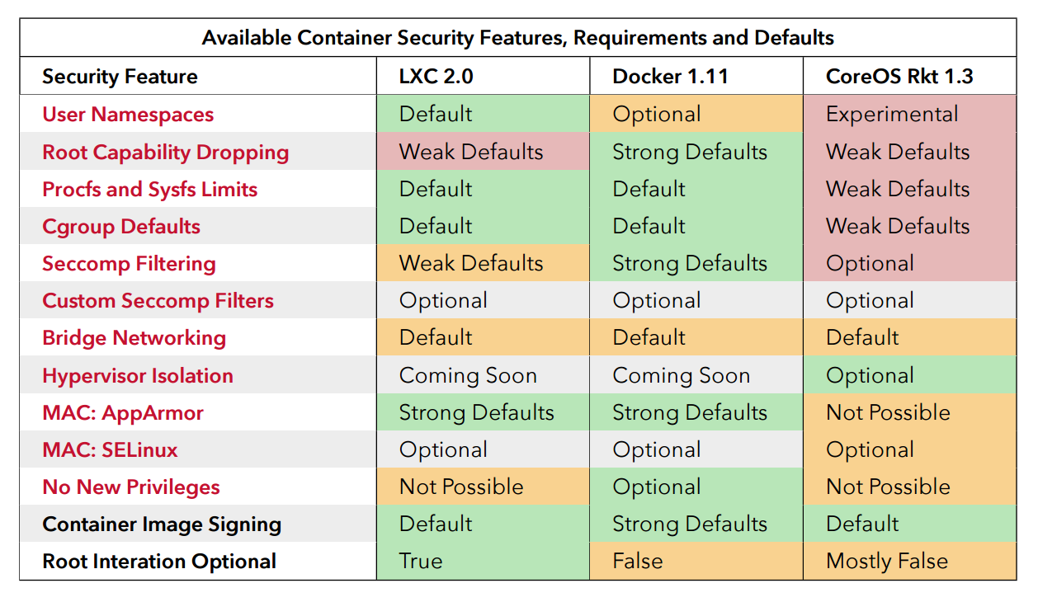
Security
source: “Understanding and Hardening Linux Containers”, page 96

Slide 33
Docker Run Platforms
Various Linux distributions (Ubuntu, Fedora, RHEL, Centos, openSUSE, ...)
Cloud (Amazon EC2, Google Compute Engine, Rackspace)
Windows, OSX: Docker Toolbox

Slide 34
Docker Ecosystem
Docker Engine or “Docker” creates and runs Docker containers. Install Docker on Ubuntu, Mac OS X, or Windows.
Docker Hub Public registry service for managing images.
Docker Registry provides open source Docker image distribution.
Docker Swarm used to host clustering and container scheduling.

Slide 35
Docker Ecosystem
Kitematic is the desktop GUI for Docker.
Docker UI is a web responsive GUI to administrate Docker
Docker Trusted Registry (DTR) supplies a private dedicated image registry.
Docker Machine automates container provisioning on your network or in the cloud. Install machine on Windows, Mac OS X, or Linux.
Docker Compose defines multi-container applications. You can install Docker Compose on Ubuntu, Mac OS X, and other systems.

Slide 36
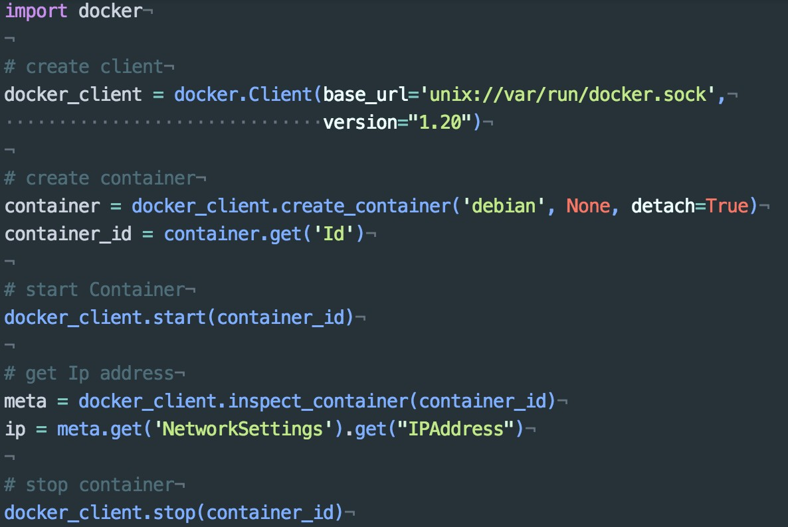
Docker APIs - Python

Slide 37


